Slide 1
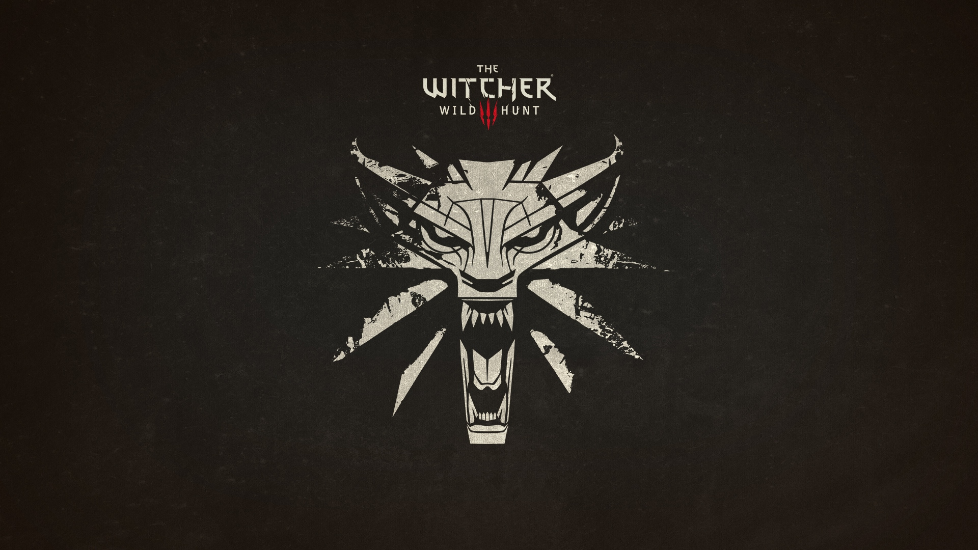
the witcher3

Slide 2
introduction
The Witcher 3: Wild Hunt^{[a]} is a open world action role-playing video game developed by CD Projekt RED.^{[5]} Announced in February 2013, it was released worldwide for Microsoft Windows, PlayStation 4, and Xbox One on 19 May 2015
The witcher: October 2007
The witcher2: May 2011

Slide 3
Overview about steam
Steam is a digital distribution platform developed by Valve Corporation offering digital rights management (DRM), multiplayer gaming and social networking services. Steam provides the user with installation and automatic updating of games on multiple computers
developed for use on Microsoft Windows, versions for OS X and Linux operating systems

Slide 4
The importance for steam
Its one of the top playing game on steam
The Witcher 3 sells 6m copies in six weeks
Apparently there have been 1m activations of The Witcher 3 on CD Projekt's game download shop GOG.

Slide 5
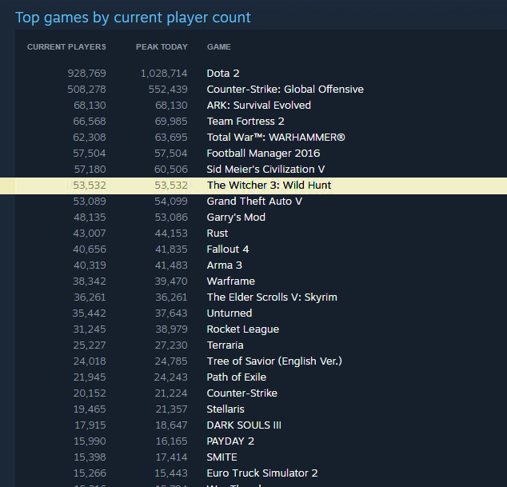

Slide 6
Production process
Producer
Publisher Development team :
Designer, Artist, Programmer, Sound engineer, Tester
Development process: metropolis CD project red
Pre-production:
Concept(story board
Production:
modeling,
texring,
lighting,rigging,
motion capture
rendering
Post-production:
Development and maintenance and marketing

Slide 7
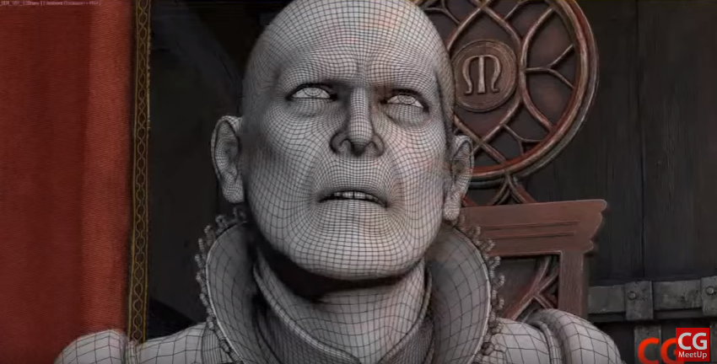
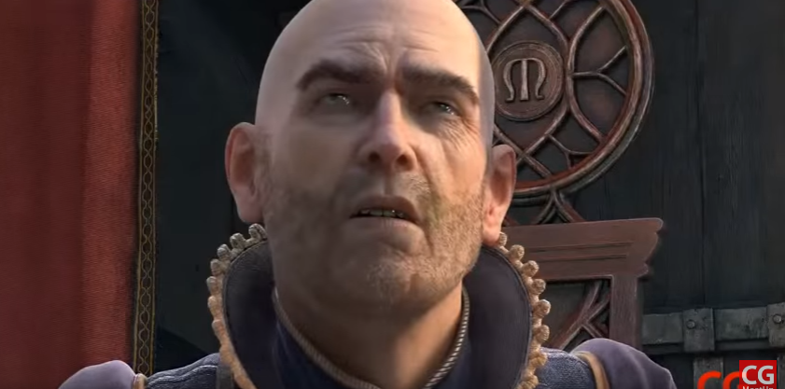
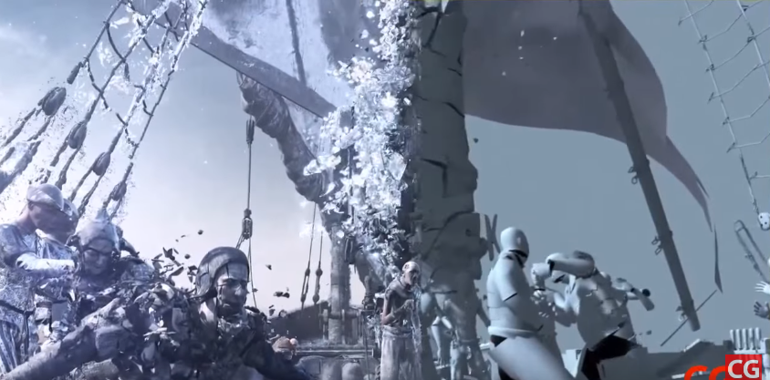

Slide 8
The story
The Witcher is a story-driven, next-generation open world role-playing game, set in a visually stunning fantasy universe, full of meaningful choices and impactful consequences. In The Witcher, you play as Geralt of Rivia, a monster hunter tasked with finding a child from an ancient prophecy.

Slide 9
What makes the games so Special
it requiring a massive 50GB of storage space
Its actually a polish best selling book series(Andrzej Sapkowski)
they make a TV show of the game
There are many references or hiding messages in the game
If you import a save form witcher2 into witcher3 it may have a little impact on it
The game have many examples of the polish mythology, or history
The great visual effects in the game

Slide 10
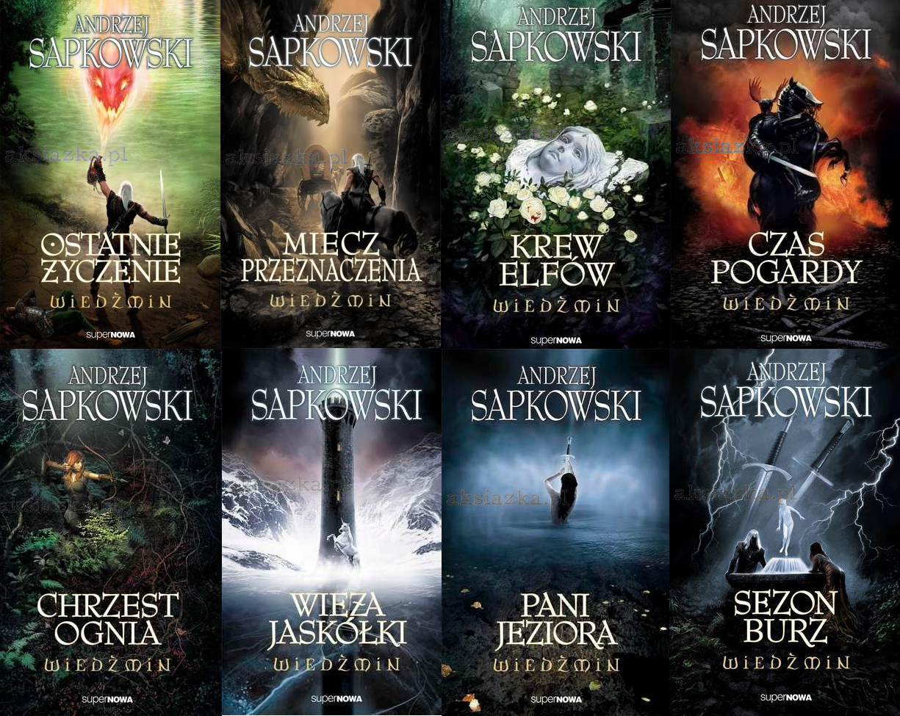

Slide 11
http://store.steampowered.com/app/292030/?l=romanian
https://en.wikipedia.org/wiki/The_Witcher_3:_Wild_Hunt
https://en.wikipedia.org/wiki/Steam_(software)
http://www.eurogamer.net/articles/2015-08-26-the-witcher-3-sells-6m-copies-in-six-weeks
http://attackofthefanboy.com/news/the-witcher-3-wild-hunt-download-sizes-revealed-across-all-platforms/
https://www.youtube.com/watch?v=jia9UAUsLug

